Slide 1

[JAVA] Exceptional Handling & Logging for Junior Developers
AXON ACTIVE VIETNAM
Ver 1.0

Slide 2
AGENDA
Logging using Log4j
“Logging” Best Practices
Exception Handling
“Exception Handling” Best Practices

Slide 3
LOGGING USING LOG4J

Slide 4
Logging using Log4j
Log4j - logging library for Java
Logging Levels (in lowest to highest order)
The standard levels of Log4j are ordered as
ALL < TRACE < DEBUG < INFO <
WARN < ERROR < FATAL < OFF

Slide 5
Logging using Log4j
Level | Description
ALL | The lowest possible rank and is intended to turn on all levels of logging including custom levels.
TRACE | Introduced in log4j version 1.2.12, this level gives more detailed information than the DEBUG level.
DEBUG | Designates fine-grained informational messages that are most useful to debug an application.
INFO | Designates informational messages that highlight the progress of the application at coarse-grained level.

Slide 6
Logging using Log4j
Level | Description
WARN | Designates potentially harmful situations. This level can be used to warn usage of deprecated APIs, poor use of API, 'almost' errors and other runtime situations that are undesirable or unexpected, but not necessarily ―wrong‖.
ERROR | Designates error events that might still allow the application to continue running. This level can be used to inform about a serious error which needs to be addressed and may result in unstable state.
FATAL | Designates very severe error events that will presumably lead the application to abort.
OFF | The highest possible rank and is intended to turn off logging.

Slide 7
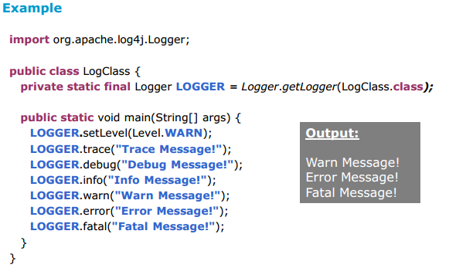
How logging level works?
A logging request of a particular level is said to be enabled if that level is higher than or equal to the level of its logger.

Slide 8
“LOGGING” BEST PRACTICES

Slide 9
Logging – Best practices
Declare the logger to be both static and final to ensure that every instance of a class shares the common logger object.
Add code to check whether logging has been enabled at the right level.
Use meaningful log messages that are relevant to the context.
Better to use logging only to log the following:
method entry (optionally with the method's input parameter values)
method exit
root cause message of exceptions that are handled at the exception's origin point.

Slide 10
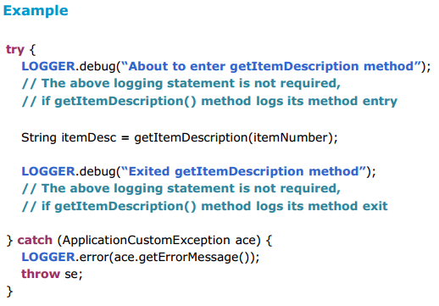
Logging – Best practices
Any other intermediate redundant logging statements, which are used just for the purpose of debugging can still be avoided.

Slide 11
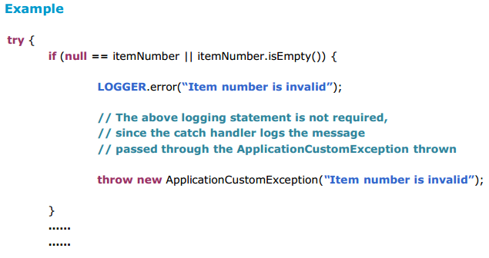
Logging – Best practices
Avoid logging at 'every' place where a custom exception is thrown. Instead log the custom exception's message in its 'catch' handler.

Slide 12
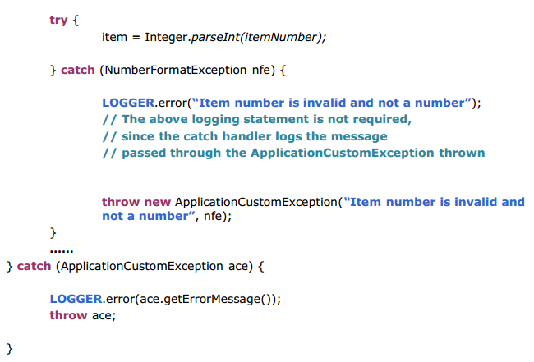
Logging – Best practices

Slide 13
EXCEPTION HANDLING

Slide 14
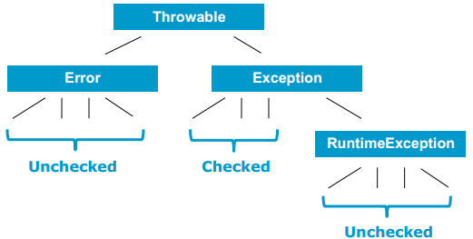
Exception
Exception
An exception is an object that represents an abnormal event. When one method (caller) calls another method (callee), they may communicate about what happened via an exception.
Types of Exception
When one method throws an exception, that exception can be either a checked exception or an unchecked exception.

Slide 15
Exception related terminologies
A method may not handle exceptions thrown within it and would instead throw it up the method call stack to let its caller know that an abnormal event occurred. It does so by declaring that exception in the throws clause of its declaration. This is called 'ducking'.
The caller itself may handle the exception thrown by its caller or in turn propagate that to its own caller. This is also called 'ducking'.
A method may translate an exception thrown by its caller into another exception and throw the new exception (to its own caller).

Slide 16
“EXCEPTION HANDLING” BEST PRACTICES

Slide 17
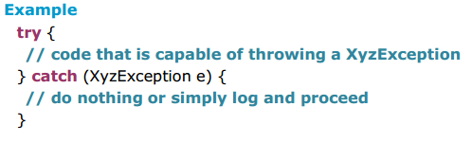
Exception handling – Best Practice #1
Handle Exceptions close to its origin
Does NOT mean “catch and swallow” (i.e. suppress or ignore exceptions)
It means, “log and handle the exception right there” or “log and throw the exception up the method call stack using a custom exception relevant to that source layer” and let it be handled later by a method up the call stack.
DAO layer – DataAccessException
Business layer – Application's Custom Exception (example -SKUException)

Slide 18
Exception handling – Best Practice #1
Note
The approach “log and handle the exception right there” makes way to use the specific exception type to differentiate exceptions and handle exceptions in some explicit manner.
The approach “log and throw the exception up the method call stack using a custom exception relevant to that source layer” – makes way for creation of groups of exceptions and handling exceptions in a generic manner.

Slide 19
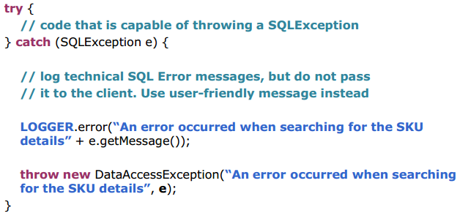
Exception handling – Best Practice #1
Note
When catching an exception and throwing it using an exception relevant to that source layer, make sure to use the construct that passes the original exception's cause. This will help preserve the original root cause of the exception.

Slide 20
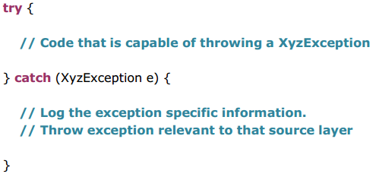
Exception handling – Best Practice #2
Log Exceptions just once and log it close to its origin
Logging the same exception stack trace more than once can confuse the programmer examining the stack trace about the original source of exception. So, log Exceptions just once and log it close to its origin

Slide 21
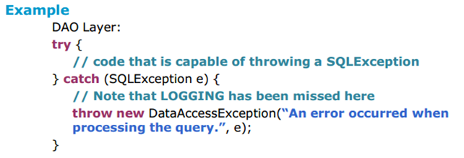
Exception handling – Best Practice #2
Note
There is an exception to this rule, in case of existing code that may not have logged the exception details at its origin.
In such cases, it would be required to log the exception details in the first method up the call stack that handles that exception. But care should be taken NOT to COMPLETELY overwrite the original exception's message with some other message when logging.

Slide 22
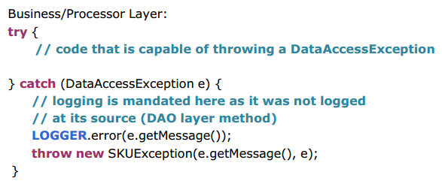
Exception handling – Best Practice #2
Since logging was missed in the exception handler of the DAO layer, it is mandated in the exception handler of the next enclosing layer – in this example it is the (Business/ Processor) layer.

Slide 23
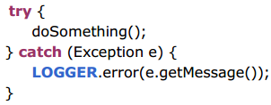
Exception handling – Best Practice #3
Do not catch “Exception”
Accidentally swallowing RuntimeException
This code
also captures any RuntimeExceptions that might have been thrown by doSomething,
ignores unchecked exceptions and
prevents them from being propagated.
So, all checked exceptions should be caught and handled using appropriate catch handlers. And the exceptions should be logged and thrown to the outermost layer (i.e. the method at the top of the calling stack) using application specific custom exceptions relevant to that source layer.

Slide 24
Exception handling – Best Practice #4
Handle Exceptions before sending response to Client
The layer of code component (i.e. the method at the top of the
calling stack) that sends back response to the client, has to do the following:
catch ALL checked exceptions and handle them by creating proper error response and send it back to client.
NOT allow any checked exception to be ―thrown‖ to the client.
handle the Business layer exception and all other checked exceptions raised from within the code in that layer separately.
Examples of such components are:
Service layer Classes in Web Service based applications
Action Classes in Struts framework based applications

Slide 25
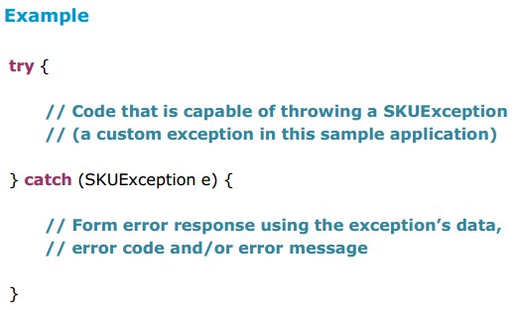
Exception handling – Best Practice #4

Slide 26
Exception handling – Best Practice #4
An exception to handling “Exception” – Case 1
There would be situations (although rarely) where the users would prefer a user-friendly/easy to understand message to be shown to them, instead of the system defined messages thrown by unrecoverable exceptions.
In such cases, the method at the top of the calling stack, which is part of the code that sends response to the client is expected to handle all unchecked exceptions thrown from within the 'try' block.
By doing this, technical exception messages can be replaced with generic messages that the user can understand. So, a catch handler for 'Exception' can be placed in it.
This is an exception to best practice #3 and is only for the outermost layer. In other layers downstream in the layered architecture, catching 'Exception' is not recommended for reasons explained under best practice #3.

Slide 27
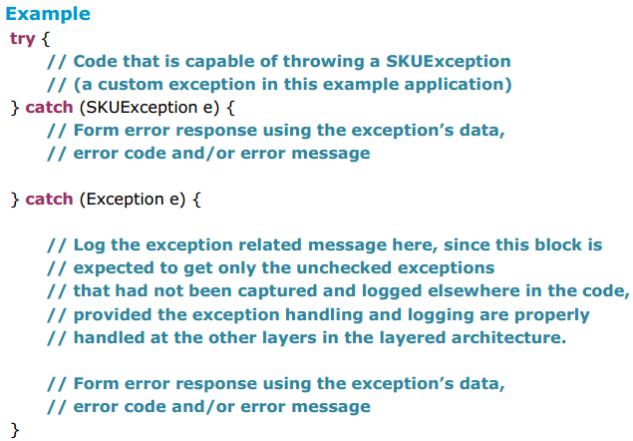
Exception handling – Best Practice #4

Slide 28
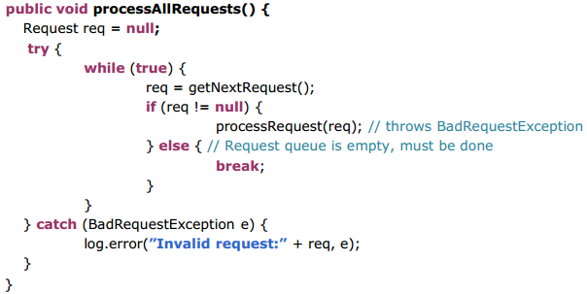
Exception handling – Best Practice #4
An exception to handling “Exception ” – Case 2
Certain other exceptional cases justify when it is handy and required to catch generic Exceptions. These cases are very specific but important to large, failure-tolerant systems.
Consider a request processing system that reads requests from a queue of requests and processes them in order.

Slide 29
Exception handling – Best Practice #4
With the above code, if any exception occurs while the request is being processed (either a BadRequestException or any subclass of RuntimeExceptionincluding NullPointerException), then that exception will be caught outside the processing 'while' loop.
So, any error causes the processing loop to stop and any remaining requests will not be processed. That represents a poor way of handling an error during request processing.
A better way to handle request processing is to make two significant changes to the logic:
1) Move the try/catch block inside the request-processing loop. That way, any errors are caught and handled inside the processing loop, and they do not cause the loop to break. Thus, the loop continues to process requests, even when a single request fails.
2) Change the try/catch block to catch a generic Exception, so any exception is caught inside the loop and requests continue to process.

Slide 30
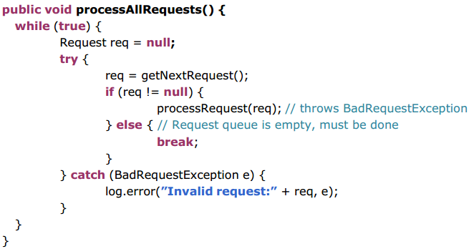
Exception handling – Best Practice #4

Slide 31
Exception handling – Best Practice #4
Catching a generic Exception sounds like a direct violation of
the maxim suggested in best practice #3 —and it is. But the
circumstance discussed is a specific and special one. In this case,
the generic Exception is being caught to prevent a single exception
from stopping an entire system.
In situations where requests, transactions or events are
being processed in a loop, that loop needs to continue to process
even when exceptions are thrown during processing.

Slide 32
Exception handling – Best Practice #5
Handling common Runtime Exceptions
NullPointerException
It is the developer's responsibility to ensure that no code can throw it.
Run CodePro and add null reference checks wherever it has been missed.
NumberFormatException, ParseException
Catch these and create new exceptions specific to the layer from which it is thrown (usually from business layer) using user -friendly and non technical messages.
To avoid ClassCastException, check the type of the class to be cast using the instanceof operator before casting.
To avoid IndexOutOfBoundsException, check the length of the array before trying to work with an element of it.
To avoid ArithmeticException, make sure that the divisor is not zero before computing the division.

Slide 33
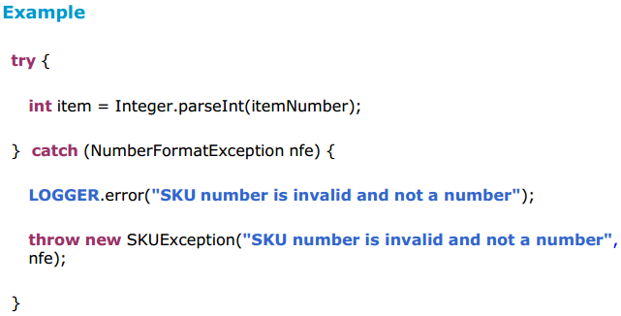
Exception handling – Best Practice #5
All other unchecked exceptions (RuntimeExceptions) will be caught and handled by the 'Exception' handler in the outermost layer (as explained in Best Practice #4 - Case 1).

Slide 34
Exception handling – Best Practice #6
Document Exceptions Thrown in Javadoc
For each method that throws checked exceptions, document each exception thrown with a @throws tag in its Javadoc, including the condition under which the exception is thrown.

Slide 35
THANK YOU

